Slide 1
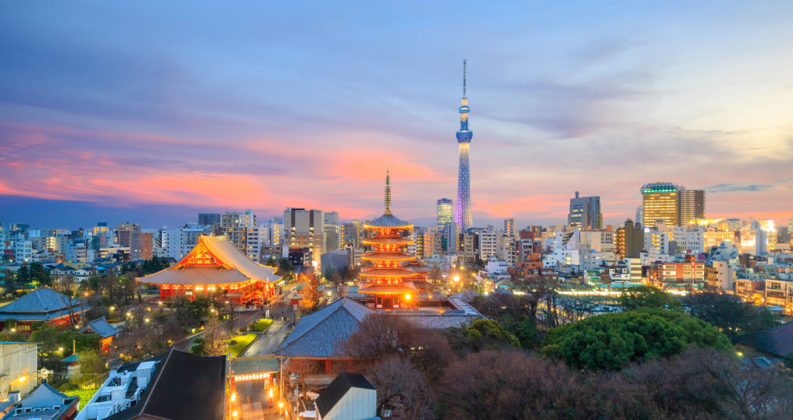
The Best of Tokyo
- Coursera Capstone Project

Slide 2
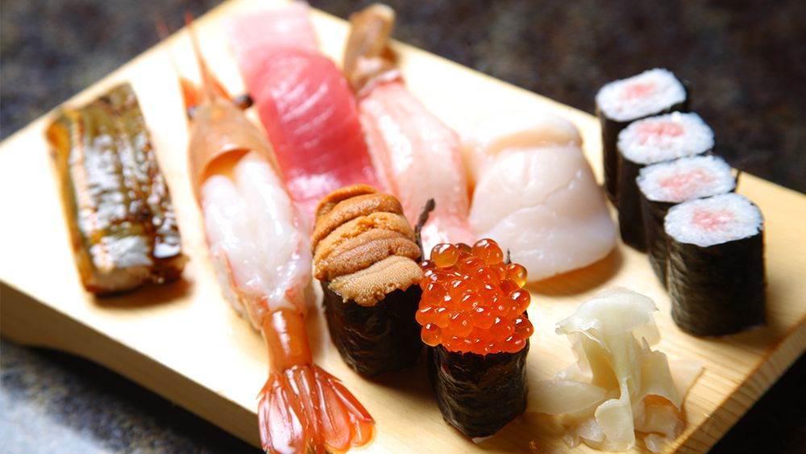

Slide 3

Background
Tokyo, the capital of japan, is one of the most desirable places people would love to visit. A trip without visiting this legendary capital city is incomplete. The cherry blossom festival and the fall foliage attract people around all around the world.

Slide 4
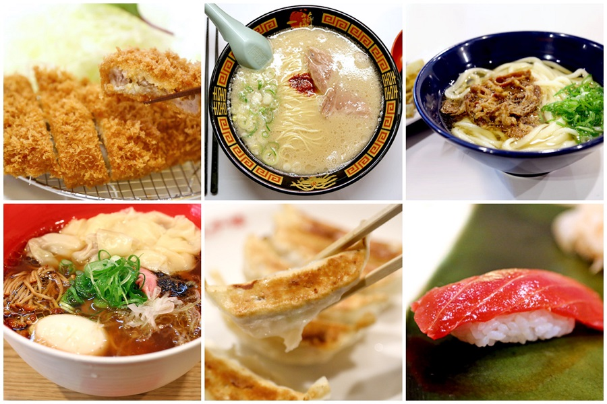
Motivation
Tokyo is also a "battleground" for good food.
ramen
edomae-zushi
monjayaki
unaju

Slide 5
Goal
Explore Tokyo
have an insight of districts and restaurants across Tokyo cities
help visitors quickly locate and choose the place to visit and enjoy a nice meal.

Slide 6
Dataset
Location Data:
Foursquare location information to retrieve the raw data
Link: https://en.wikipedia.org/wiki/Special_wards_of_Tokyo
A list of special wards table from the Wikipedia
Including the basic information of the district name, population, density, area size, which would be the base line of our analysis.
Restaurants information
Foursquare APIs
We can use the location information to filter the restaurants information for our task.

Slide 7
Methodology
Perform statistical methods like one-hot encoding and k-means on the foursquare API, which can provide information about the popular restaurants in each distributes of Tokyo.
We will further plot the information on the Folium leaflet map as a good visualization.

Slide 8
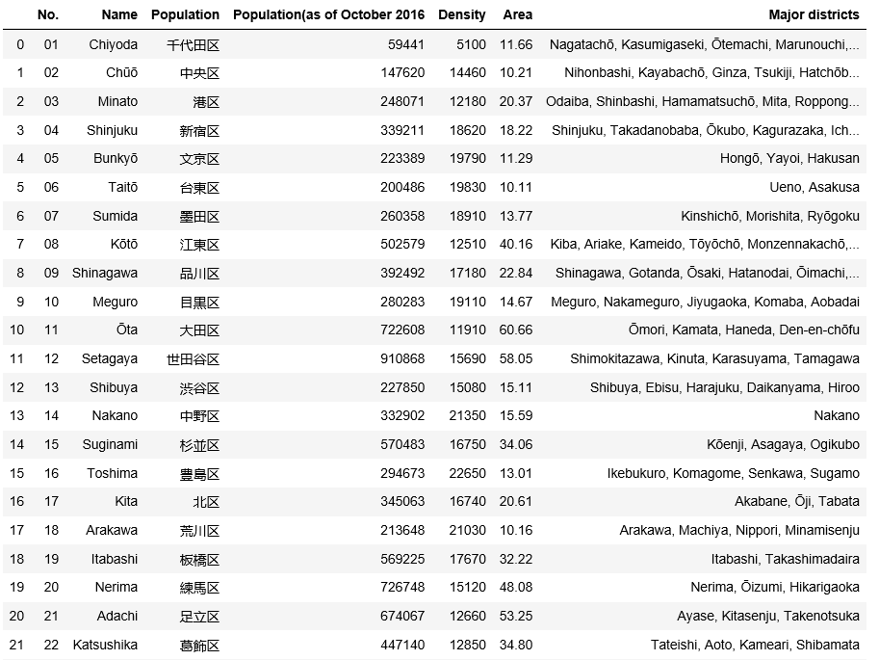
Dataset
Dataset quick look

Slide 9
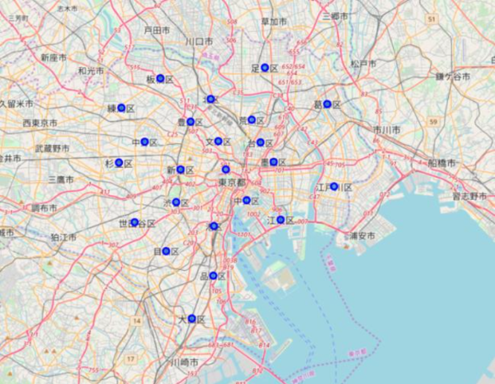
The districts in Tokyo

Slide 10
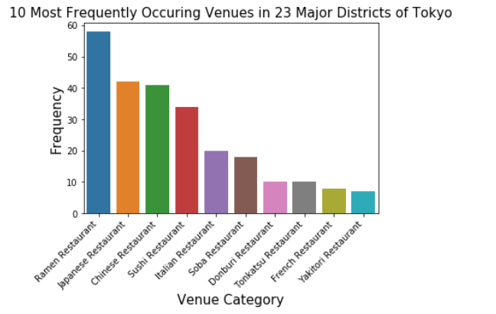
The visualization of the top 10 restaurants categories

Slide 11
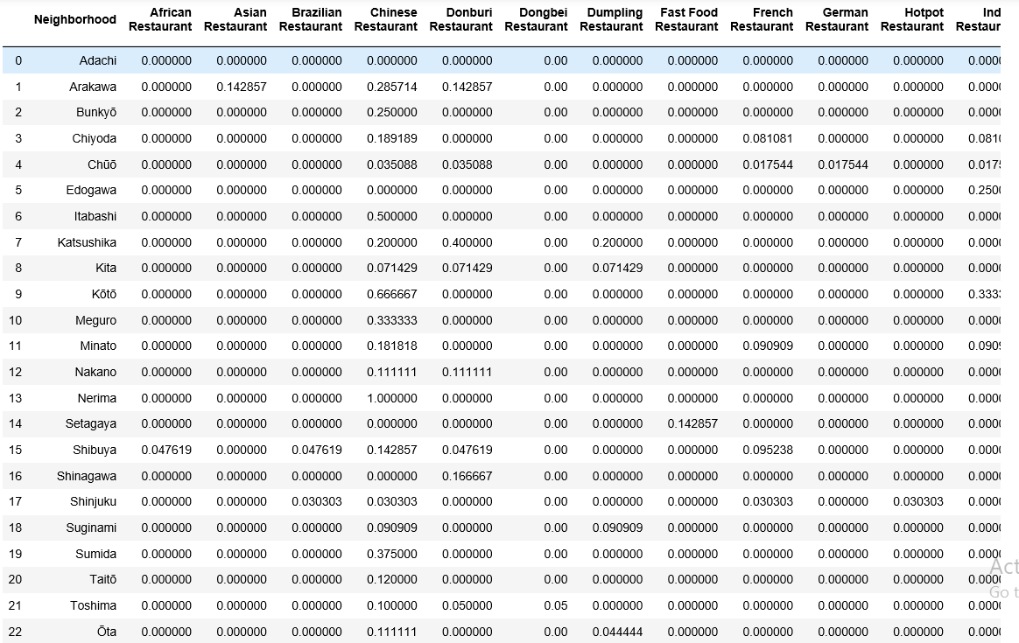
one-hot encoding
We want to have more insights about each restaurant and the popularity within different districts, so we started with one-hot encoding.

Slide 12
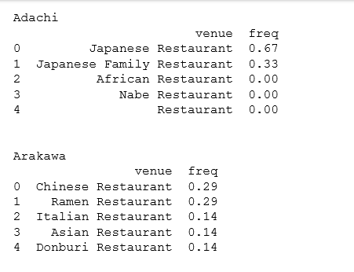
one-hot encoding -- Each district with its most popular venues
Adachi
Arakawa

Slide 13
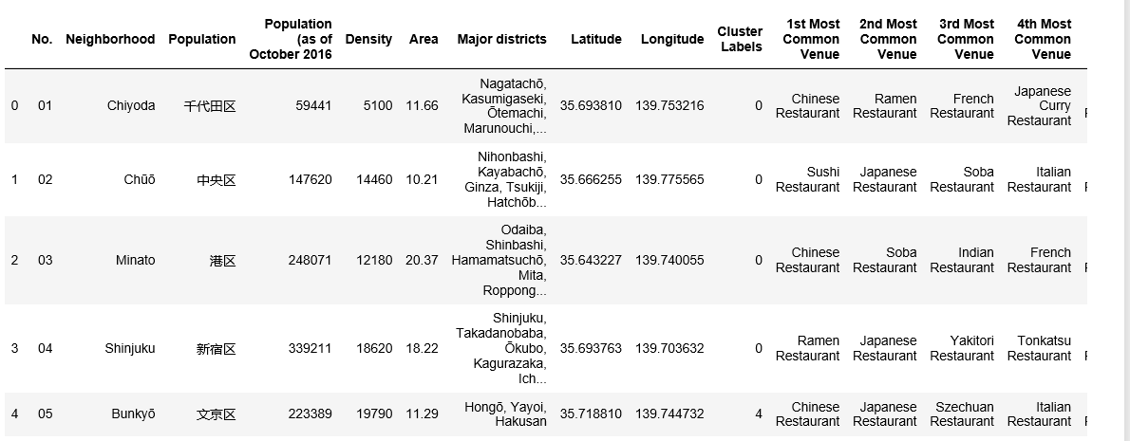
K-means clustering

Slide 14
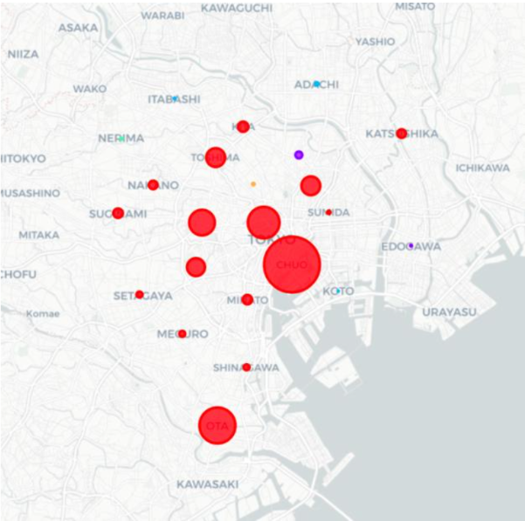
K-means clustering – Map Visualization
Project the clusters on the map

Slide 15
Conclusions
Within all the districts, Chuo has the largest number of restaurants
Ramen restaurants enjoy the highest popularities across all the categories, followed by Japanese restaurants
From the map visualization, we can see more restaurants locates in the central Tokyo, suburb areas have relatively fewer restaurants

Slide 16
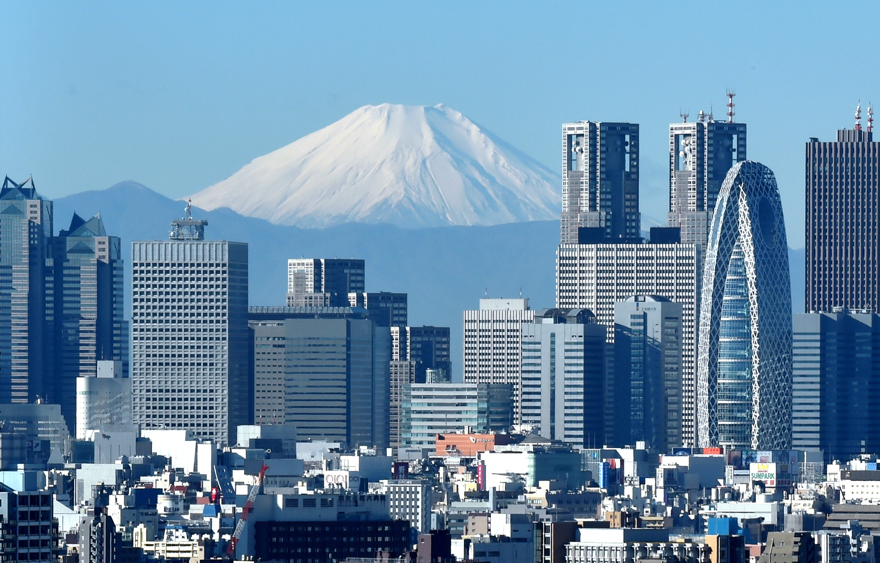
Discussions
The foursquare API collaborates with statistical methods, like one-hot encoding and k-means clustering, enable us to have an insight about the popular restaurants in each distributes of Tokyo.
The preliminary market along with Folium leaflet map facilitates good visualization, which display the location of the hotspots clearly on the map.

Slide 17
Future Work
Combine the Folium leaflet display with google map, so visitors can get more comprehensive results from the searching.
More machine learning methods can be applied on the datasets, from traditional classification and clustering methods, to the deep learning approaches, like CNN, and reinforcement learning.

Slide 18

Thank you

